Slide 1
Continuous Variable Distribution

Slide 2
Continuous Random Variables
Service time
Installation time
Download time Failure time,
Weight
Height
Distance
Velocity
Temperature
Connection speed

Slide 3
Introduction
Recall that any discrete distribution is concentrated on a finite or countable number of isolated values.
Conversely, continuous variables can take any value of an interval, (a, b), (a, +∞), (−∞, +∞), etc.

Slide 4
Probability Distribution Functions
PMF
Probability Mass Function
PDF
Probability Density Function
Applies on Continuous Variables
CDF
Cumulative Distribution Function
Applies on both Discrete and continuous variable(s)
Applies on Discrete Variables

Slide 5
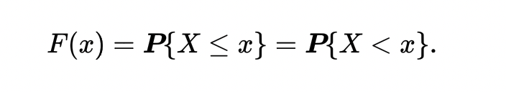
For all continuous variables, the probability mass function (PMF) is always equal to zero,
P(x)=0 for all x.
As a result, the PMF does not carry any information about a random variable. Rather, we can use the cumulative distribution function (CDF) F(x). In the continuous case, it equals

Slide 6
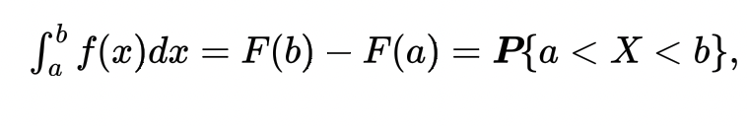
Probability Density Function
Probability density function (PDF, density) is the derivative of the cdf,
f(x) = F′(x). The distribution is called continuous if it has a density.
Then, F(x) is an antiderivative of a density. By the Fundamental Theorem of Calculus, the integral of a density from a to b equals to the difference of antiderivatives, i.e.,

Slide 7
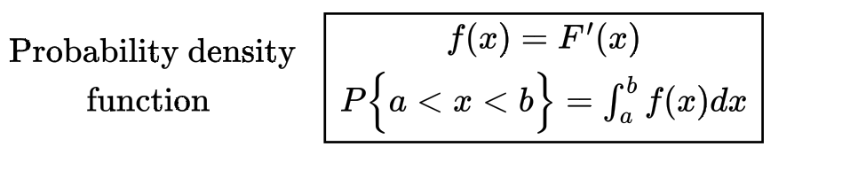
Probability Density Function

Slide 8
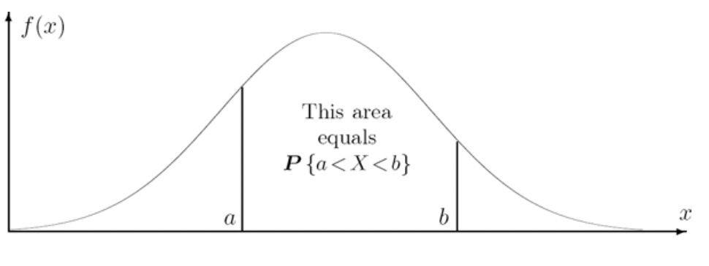
Probabilities are areas under the density curve

Slide 9
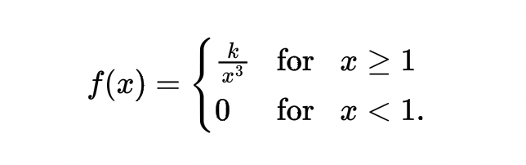
Example
The lifetime, in years, of some electronic component is a continuous random variable with the density
Find k, draw a graph of the cdf F(x), and compute the probability for the lifetime to exceed 5 years.

Slide 10
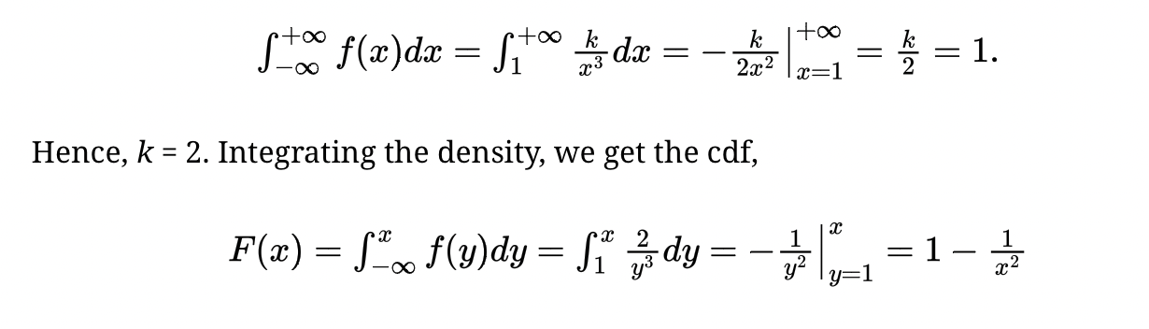
Solution
Find k from the condition ∫ f(x)dx = 1:

Slide 11
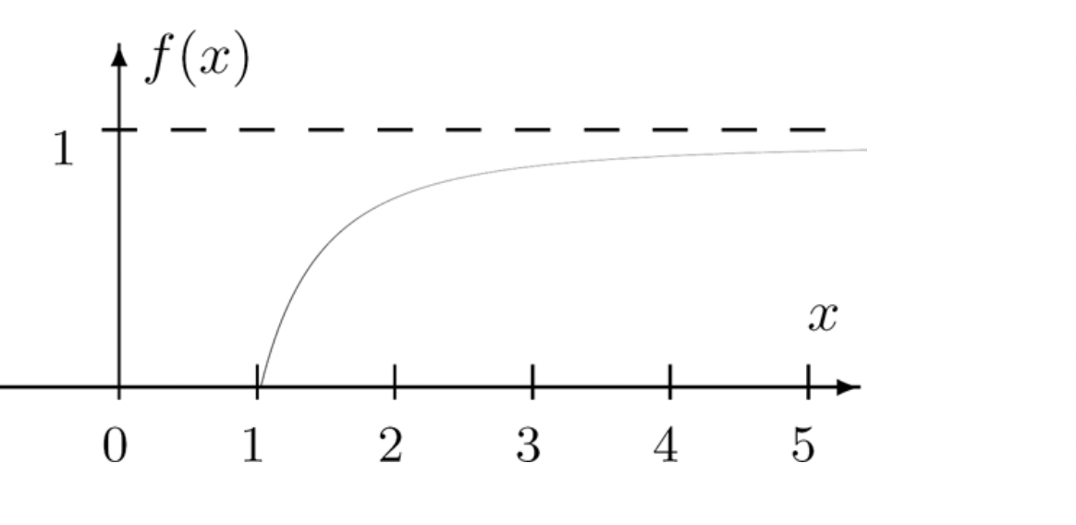
Graph for the function f

Slide 12
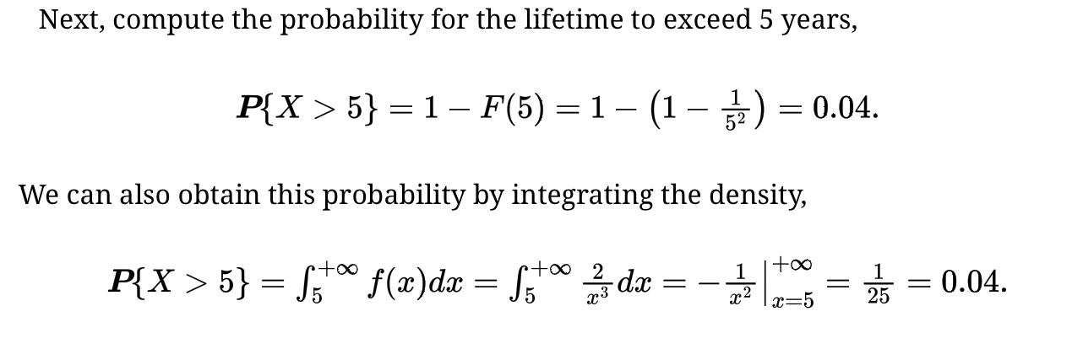

Slide 13
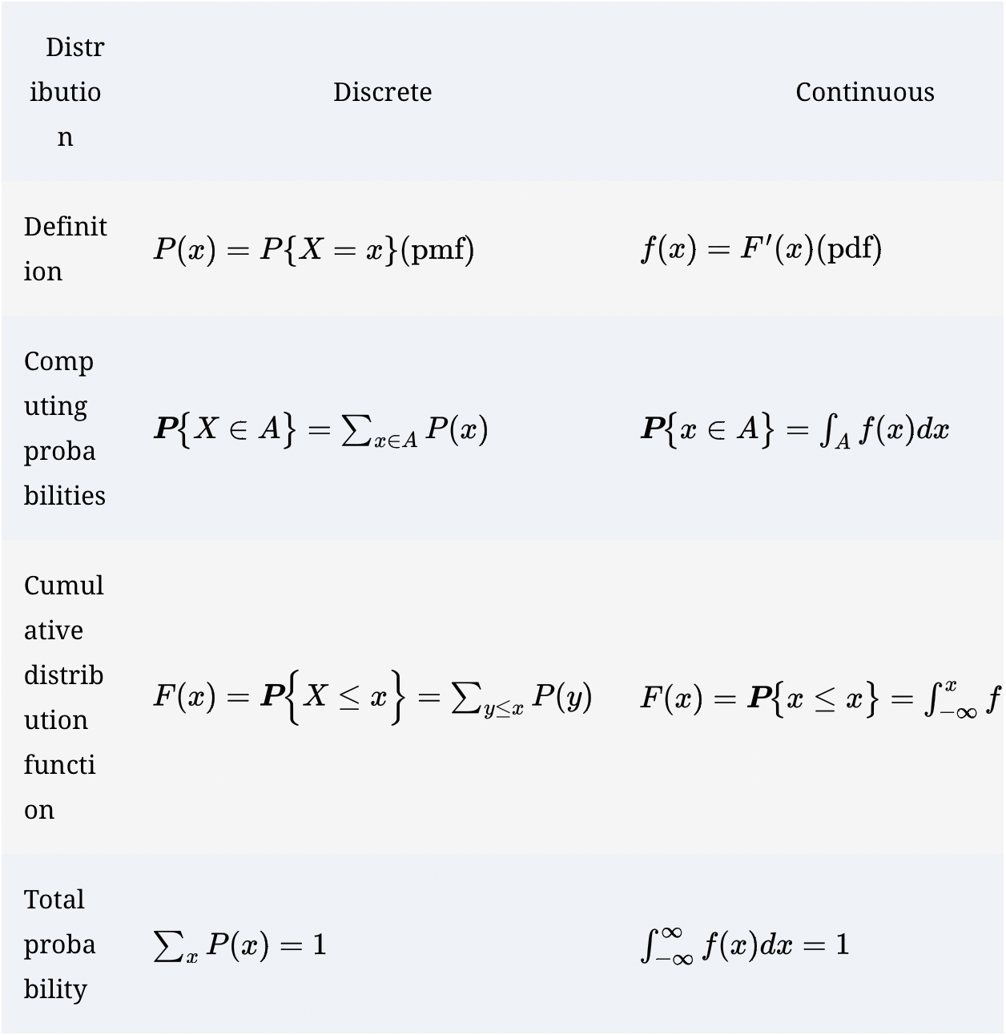

Slide 14
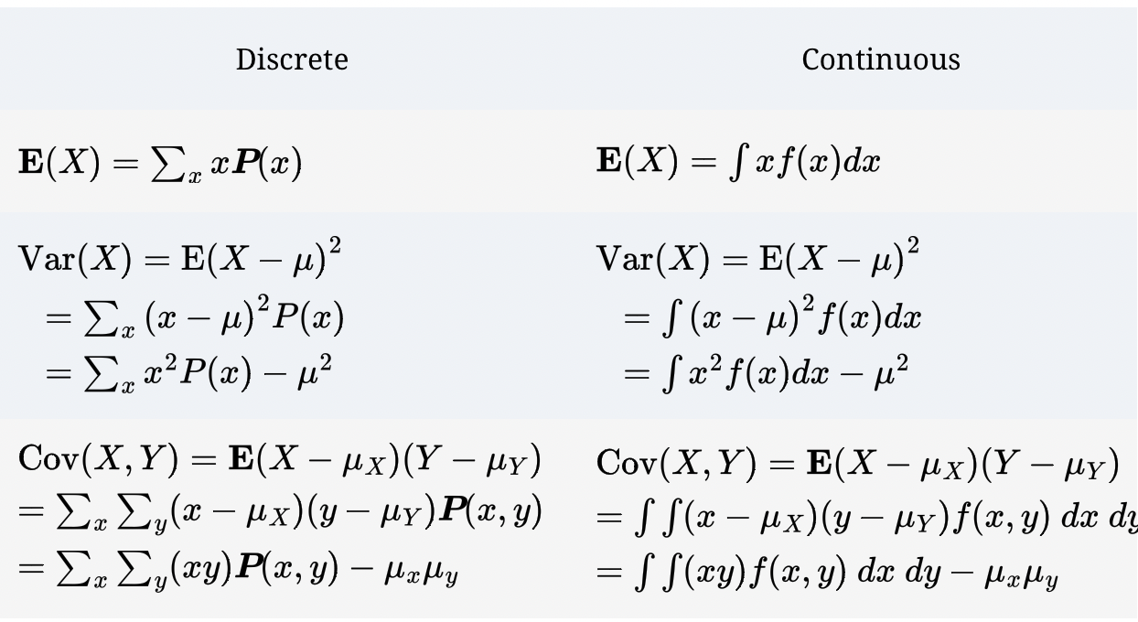

Slide 15
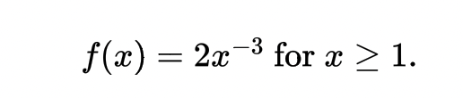
Example
A random variable X has density
Its expectation equals

Slide 16
Computing its variance, we run into a “surprise,”

Slide 17
Continuous Distributions
Uniform distribution
Exponential Distribution
Normal Distribution

Slide 18
Application of Uniform Distribution
Many computer languages and software are equipped with a random number generator that produces Uniform random variables.
Users can convert them into variables with desired distributions and use for computer simulation of various events and processes.
Also, Uniform distribution is used in any situation when a value is picked “at random” from a given interval; that is, without any preference to lower, higher, or medium values. For example, locations of errors in a program, birthdays throughout a year.

Slide 19

Uniform distribution continued
To give equal preference to all values, the Uniform distribution has a constant density. On the interval (a, b), its density equals
because the rectangular area below the density graph must equal 1.

Slide 20
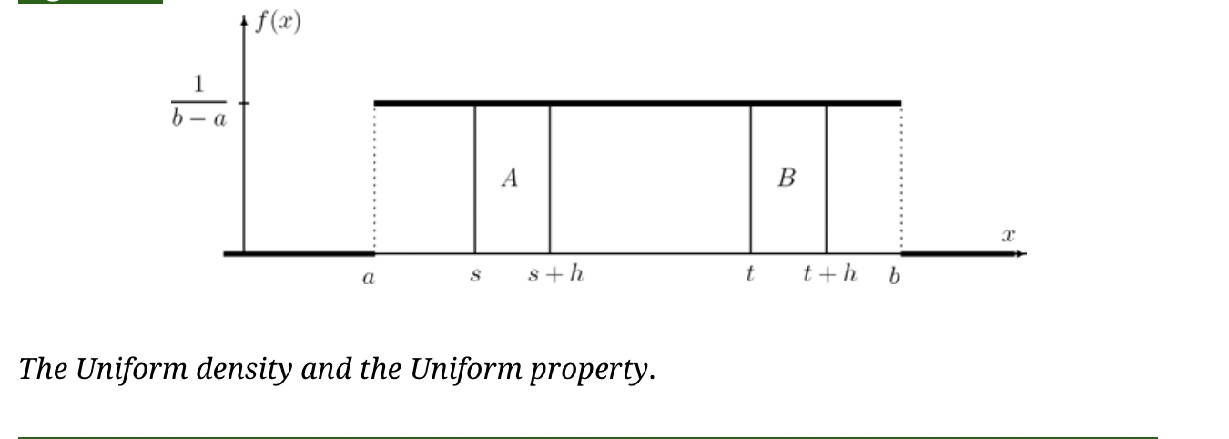

Slide 21
Example
If a flight scheduled to arrive at 5 pm actually arrives at a Uniformly distributed time between 4:50 and 5:10, then it is equally likely to arrive before 5 pm and after 5 pm, equally likely before 4:55 and after 5:05, etc.

Slide 22
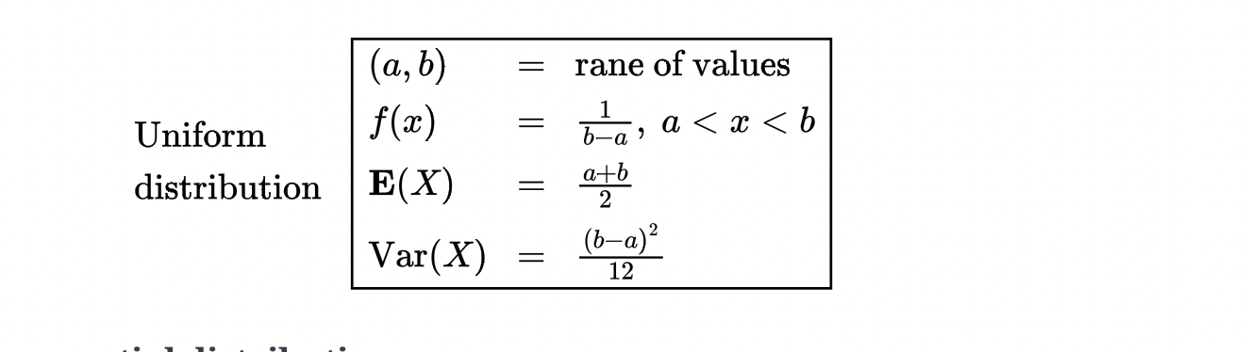

Slide 23
Exponential Distribution
Exponential distribution is often used to model time: waiting time, interarrival time, hardware lifetime, failure time, time between telephone calls, etc.
As we shall see below, in a sequence of rare events, when the number of events is Poisson, the time between events is Exponential.

Slide 24
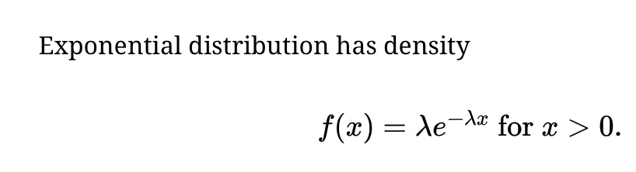
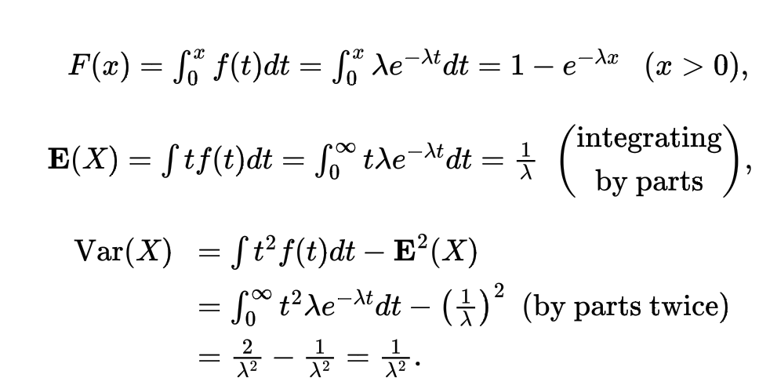

Slide 25
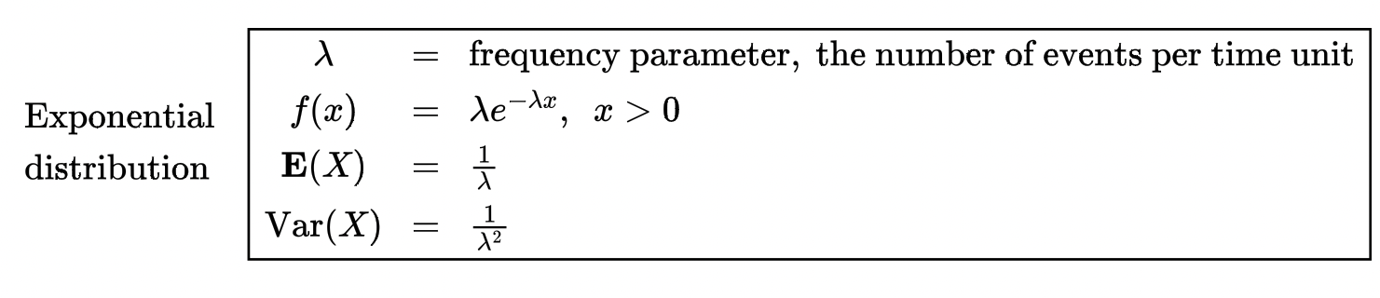

Slide 26
Example
Jobs are sent to a printer at an average rate of 3 jobs per hour.
(a) What is the expected time between jobs?
(b) What is the probability that the next job is sent within 5 minutes?
Solution. Job arrivals represent rare events, thus the time T between them is Exponential with the given parameter λ = 3 hrs⁻¹ (jobs per hour).
(a) E(T) = 1/λ = 1/3 hours or 20 minutes between jobs;
(b) Convert to the same measurement unit: 5 min = (1/12) hrs. Then,

Slide 27

Normal Distribution
Normal distribution plays a vital role in Probability and Statistics.
Normal distribution is often found to be a good model for physical variables like weight, height, temperature, voltage, pollution level, and for instance, household incomes or student grades.

Slide 28
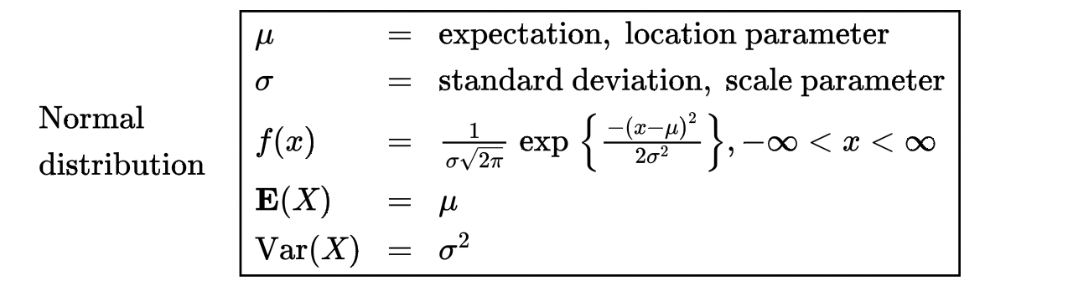

Slide 29
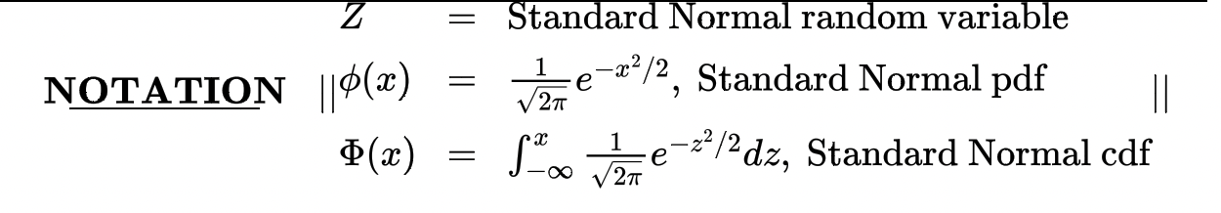
Standard Normal Distribution
Normal distribution with “standard parameters” µ = 0 and σ = 1 is called Standard Normal distribution.

Slide 30
Any questions? Let’s move on to the worksheet

